Slide 1


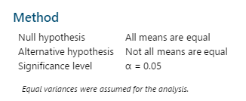


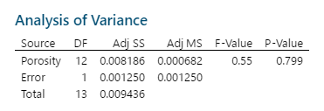
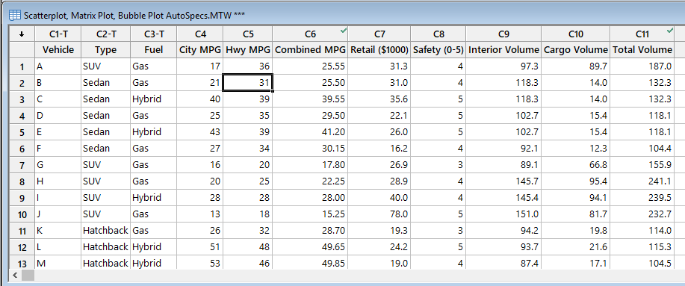
Exploratory Data Analysis Using MINITAB
ABOUT MINITAB???
Minitab is a command and menu driven software package for statistical analysis
USAGE OF MINITAB
Here Minitab is used for various statistical data analysis. From Histogram to ANOVA including Boxplot, Pie and Pareto chart, Bubble Plot, Scatterplot etc all of these are plotted here by means of MINITAB.
Matrix plot
Histogram
Scatterplot
Bubble Plot
Pie Chart
Boxplot
Contact
Navid Anas Sadman
Roll:201636036
Level: 03
Department of Industrial and Production
Military Institute of Science and Technology
Pareto Chart
ANOVA
Probability Plot

